Slide 1
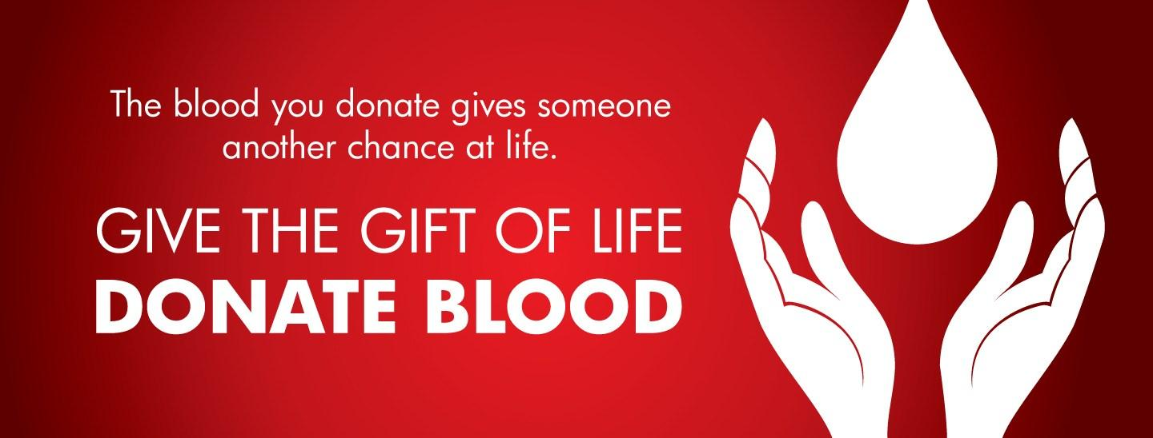

Slide 2
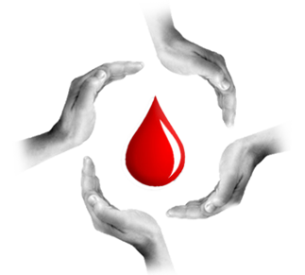
Blood Bank Application
Prepared For:
Dr. Zubair Malik
Prepared By:
Amina Anwar
Fouzia Younas
Sumaira Naz
Usama Bin Nawaz

Slide 3
Purpose
Health is a key area for improving the standard of living for the citizens of Pakistan
Build a bridge between the nearby blood donors and needy at the time of emergency
The annual number of donors bled in the city of Lahore alone is close to 300,000 in public sector Blood Banks
To reduce mortality due to unavailability of blood

Slide 4

Problem Statement
To Reduce the communication gap between donors and recipient for requirements of blood, due to unavailability of a proper platform, we are designing an android blood bank to save their loved one’s lives.

Slide 5
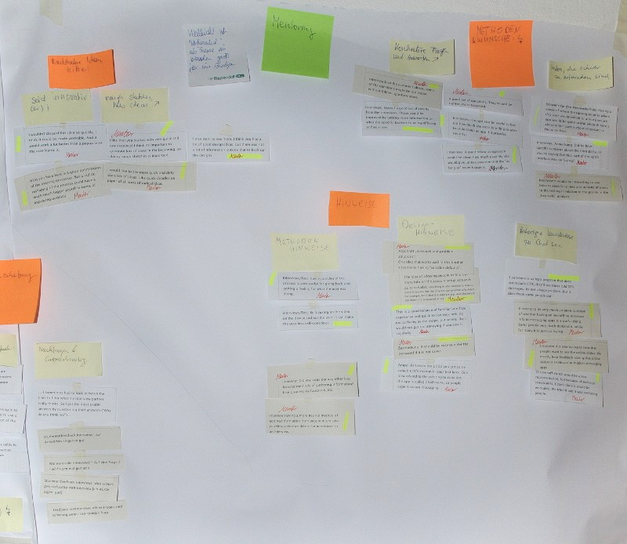
Need Finding Methodology
Stakeholder identification (what, why, how)
Interviews
Prepared questionnaire

Slide 6


Slide 7
StakeHolders
During problem identification, we recognized following stakeholders directly fall under our problem domain.
Donors
Receivers
Blood bank control
Doctors
Blood bank societies in universities

Slide 8
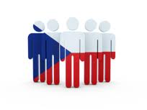

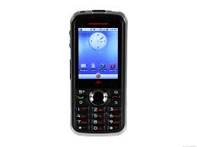

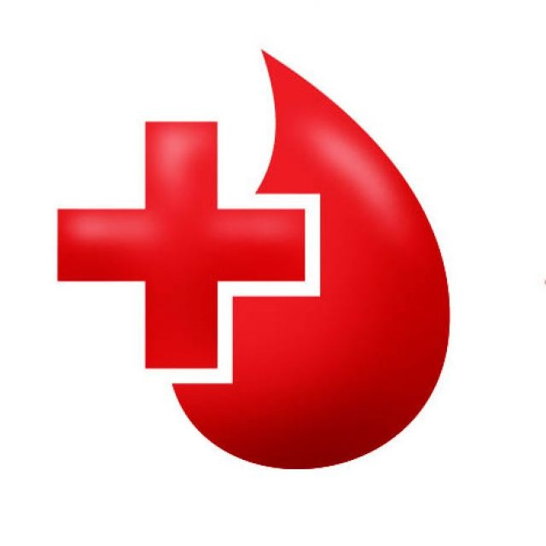
Coordination Flow
Recipient
University Representative
Feature Phone
Smart Phone
Save Life

Slide 9
Contd….
After identification of stakeholders we were able to meet them in person and interviewed
them in their respective places.
For interview purpose we prepare a structured questionnaire consisting of 13 questions

Slide 10
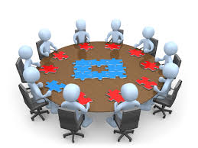
Interviews

Slide 11
Basic questions asked from general users
What kind of cell phone do you own?
Do you donate blood voluntarily?
How do you arrange blood? Methodology?
If you use any digital media for this purpose, kindly name it?
Do you get blood on time?
What are the problems you find in existing methodology?
Do you ever find any difficulty in finding blood?
Do you any application related to blood bank will be useful?

Slide 12
Basic questions asked from blood bank staff
Do you recommend any tests to donors before donating blood?
How do you know that a person can actually donate blood? Any criteria?
Any case when any abnormal symptoms appear after donation?
Do you have any restriction about age limit of a person in donation process?
Have you used any web portal or android application already?
What were the reasons of failure for that application?

Slide 13
Conducted Interviews
Conducted online survey from 200 respondents
100 questionnaire were filled online
100 were filled by face to face interaction from people
Met head(Babar Asii) of blood bank society of GCU, Lahore
Visited Jinnah Hospital and met Dr. Ashfaq, in-charge of blood bank
Visited Children Hospital and met Dr. Nisar Ahmad, in-charge of blood bank
Met Ms. Abida at PITB, who was the part of Punjab Blood Line(PBL)

Slide 14

Interview Results
From interview, we get to know that
Problem actually exists
Carelessness of blood bank staff
Don’t get blood on time
Failures of existing applications
Information about donation process
Mostly people use android phones

Slide 15
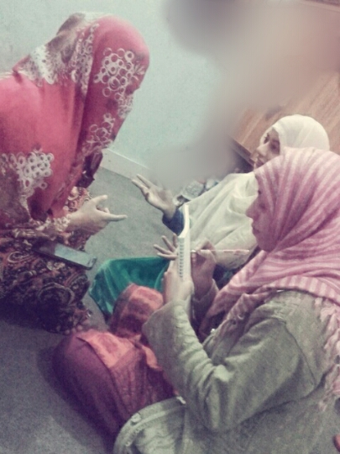

Survey recording and picture

Slide 16
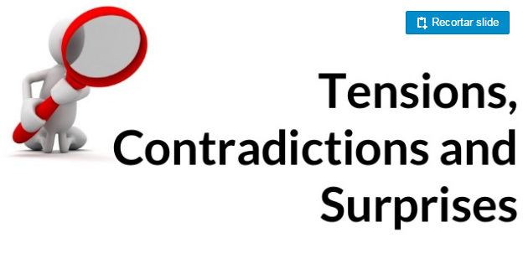

Slide 17

Face difficulty in meeting doctors and hospitals
People were not serious in giving answers
Lack of awareness

Slide 18
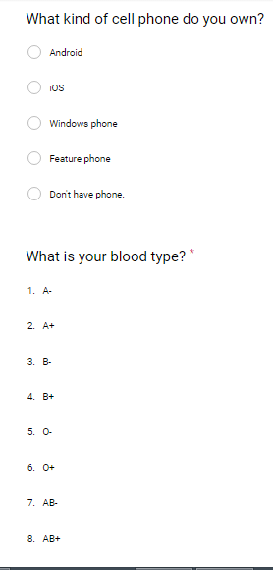
Data Analysis
We prepared structured questionnaire form
It Includes 13 questions
Here are the results of surveys conducted online

Slide 19
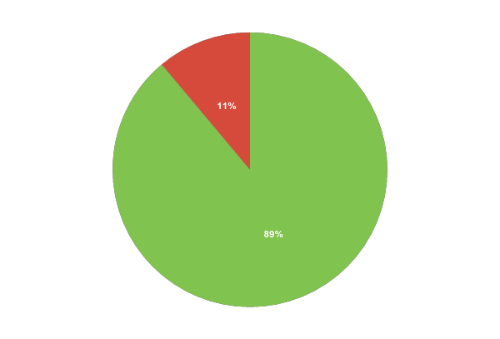

^{Mostly People} are ^{Android Phones Users}
^{Cell Phone Users}
^{89% people} use Android phones.
2
brandshareTM 2014 © Daniel J. Edelman, Inc .

Slide 20

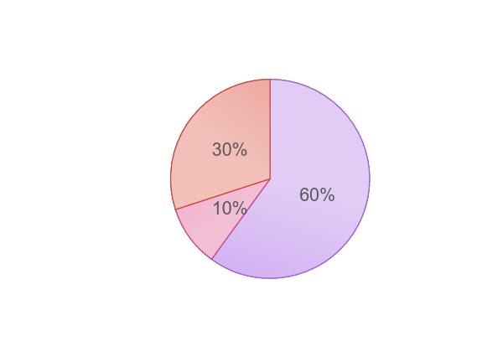


Arrangement of Blood in Pakistan
10% people arrange blood using websites and applications
30% people arrange blood
Through blood banks
60% people arrange blood by calling their relatives and friends
Mostly people arrange blood by contacting their relatives and friends
.

Slide 21


^{Only} 20% people don’t find the blood bank application useful.
⁸⁰
^{20%}
%
^{80% people find the blood bank} application useful

Slide 22
Limitations of Existing Systems
Existing systems also require sign up for recipients of blood which is not a good strategy because he is already in a terrible situation
Mostly applications show the contact numbers of donors too which is not good for security purpose
They don’t verify if a donor is eligible for donating blood i.e his duration status
Some of them are not user friendly

Slide 23
Inferences drawn from results
People face problems in finding blood
Mostly users have android phones
Any blood bank application will be useful for them.
No awareness about web applications
They need quick response in emergency

Slide 24
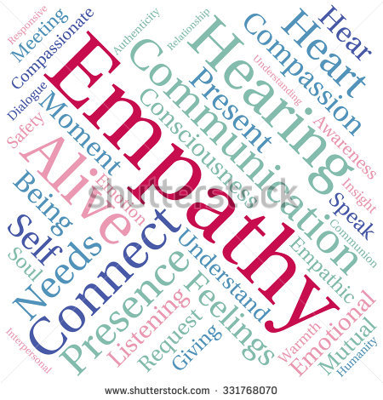

Slide 25
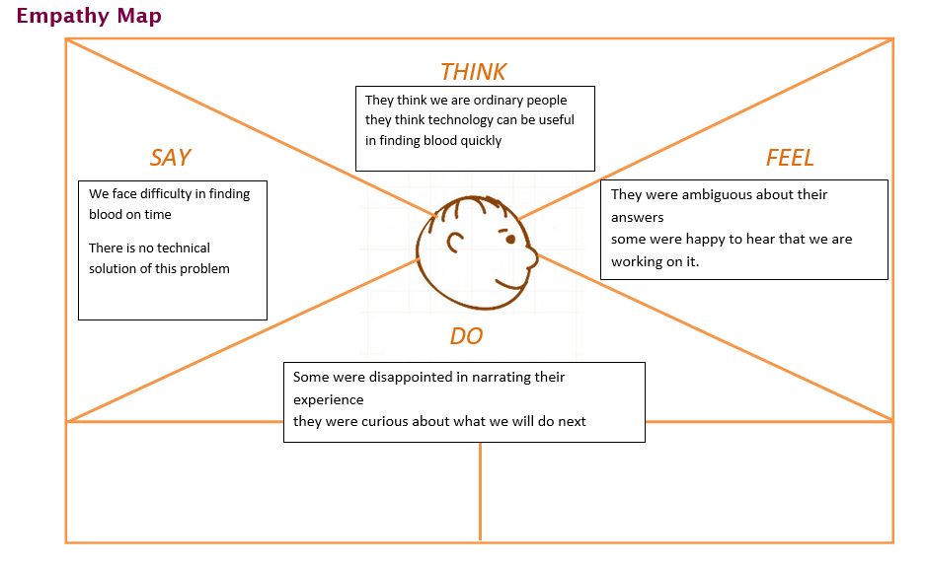

Slide 26
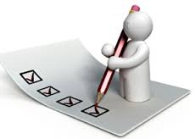
Summary
We have done
Problem identification,
Recognize stake holders
Conducted interviews
Analysis of results

Slide 27

^{THANK YOU}

